Slide 1
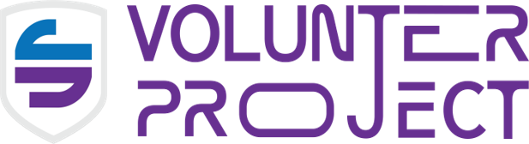
WEEK 7 · DIGITAL CITIZENSHIP
MEDIA & DIGITAL LITERACY
A reality check for everyone with a phone —
Cancel Culture
vs. Cybersecurity
Your old posts never really log off. This week: how your past gets dug up, why the internet won't forget, and how to protect your name.
Notes:
Welcome. This week we collide two ideas students think are unrelated: cancel culture (a social thing) and cybersecurity (a tech thing). The thread connecting them is their own digital footprint. Set the stakes early and keep it conversational.

Slide 2

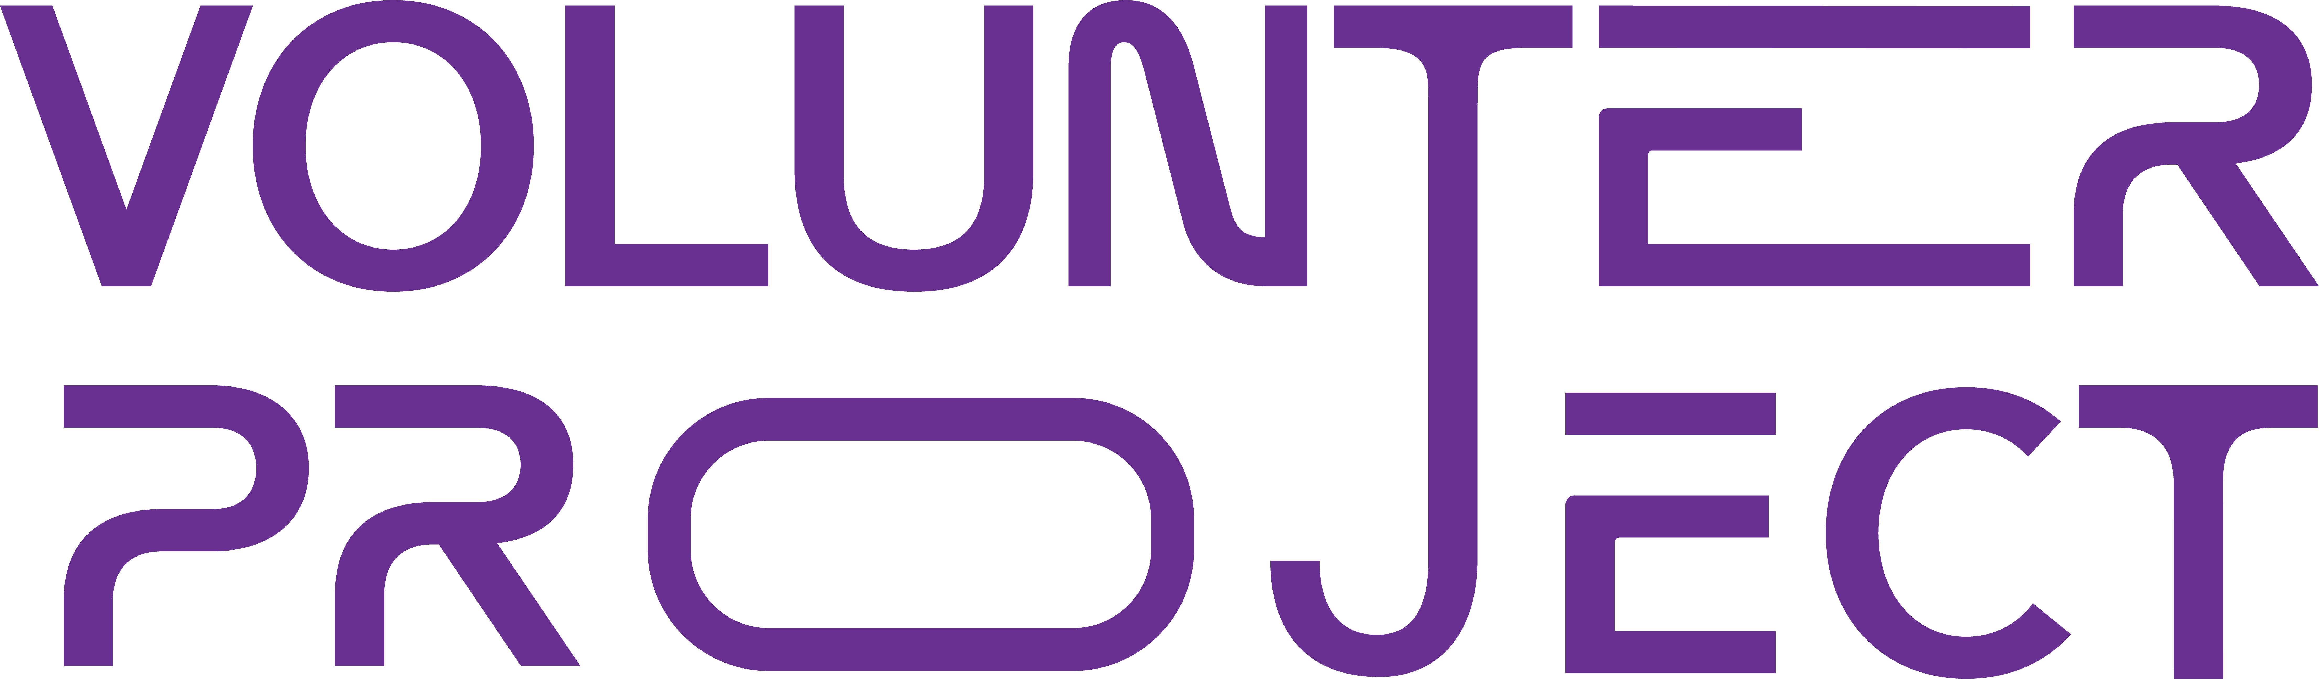
THE REALITY
A post you forgot about can get you suspended, rejected, or fired — years after you typed it.
SUSPENDED
REJECTED
FIRED
Notes:
The hook. Read the line slowly. Ask: how many of you have posted something at 13 or 14 you'd be embarrassed by now? Almost every hand goes up. That post may still exist. Cancellation isn't only for celebrities — students, athletes, and applicants get caught too.

Slide 3
TWO WORDS, ONE TARGET — YOU
Cancel Culture
Cybersecurity
The mass withdrawal of support — and pile-on of public criticism — when someone's words or actions resurface and are judged offensive. Consequences range from lost followers to lost jobs, scholarships, and admissions.
Not just stopping hackers. It's protecting your information and reputation — controlling what exists about you online, who can see it, and what it says. Your digital footprint is an asset worth defending.
The overlap between them is a single person: you.
Notes:
Define both terms in plain language. Cancel culture = the social consequence. Cybersecurity here is broader than hackers — it's protecting YOUR information and reputation, sometimes called OPSEC or digital footprint management. The overlap is the student themselves.

Slide 4
WHAT WE'LL COVER
01
Digital Archaeology
How people dig up your past
02
The Permanence of the Internet
Why nothing ever fully deletes
03
Cleaning Up
How to fix it — and when it's too late
★
Activity:
Digital Time Capsule
◆
Takeaway:
Your Brand Protection Plan
Notes:
Quick map of the lesson. Three topics, one activity, one takeaway. Tell them the activity (Digital Time Capsule) is coming so they start thinking about their own feeds.

Slide 5
01
Digital Archaeology
The art of digging through someone's online history to surface what they thought was long gone.
Notes:
Section divider. Digital archaeology = the practice of digging through someone's online history to find buried content. Anyone can do it with free tools and patience.

Slide 6
SECTION 01 · DIGITAL ARCHAEOLOGY
How people dig up your past
A
B
C
Google your name
Reverse image search
Friends' screenshots
Old handles, school pages, news mentions, and tagged photos surface in seconds.
One profile photo can connect your "anonymous" accounts to your real name.
Today's friend is tomorrow's source. Private chats get screenshotted and shared.
D
E
F
Tagged & old photos
Recycled usernames
Archive & cache tools
You don't control what others post about you — or who they tag.
Reusing one handle across apps links every account into a single trail.
Free sites store snapshots of pages even after you delete the original.
Notes:
Walk through the toolkit. Emphasize that none of this requires hacking — it's all public or semi-public. The reverse image search point surprises students: a single profile photo links your accounts together.

Slide 7
SECTION 01 · DIGITAL ARCHAEOLOGY
Who's holding the shovel?
70%
~36%
∞
of employers
of admissions officers
strangers & peers
screen candidates on social media before hiring — and over half have rejected someone for what they found.
check applicants' social profiles — and a third of those say what they saw hurt the application.
Anyone with a screenshot and a grudge can become an investigator — no permission required.
Sources: CareerBuilder employer surveys; Kaplan Test Prep admissions surveys. Figures vary year to year — the trend is steady.
Notes:
The numbers. Sources: CareerBuilder employer surveys and Kaplan Test Prep admissions surveys. Round figures — the trend matters more than the decimal. The takeaway: being checked is normal now, not paranoid.

Slide 8
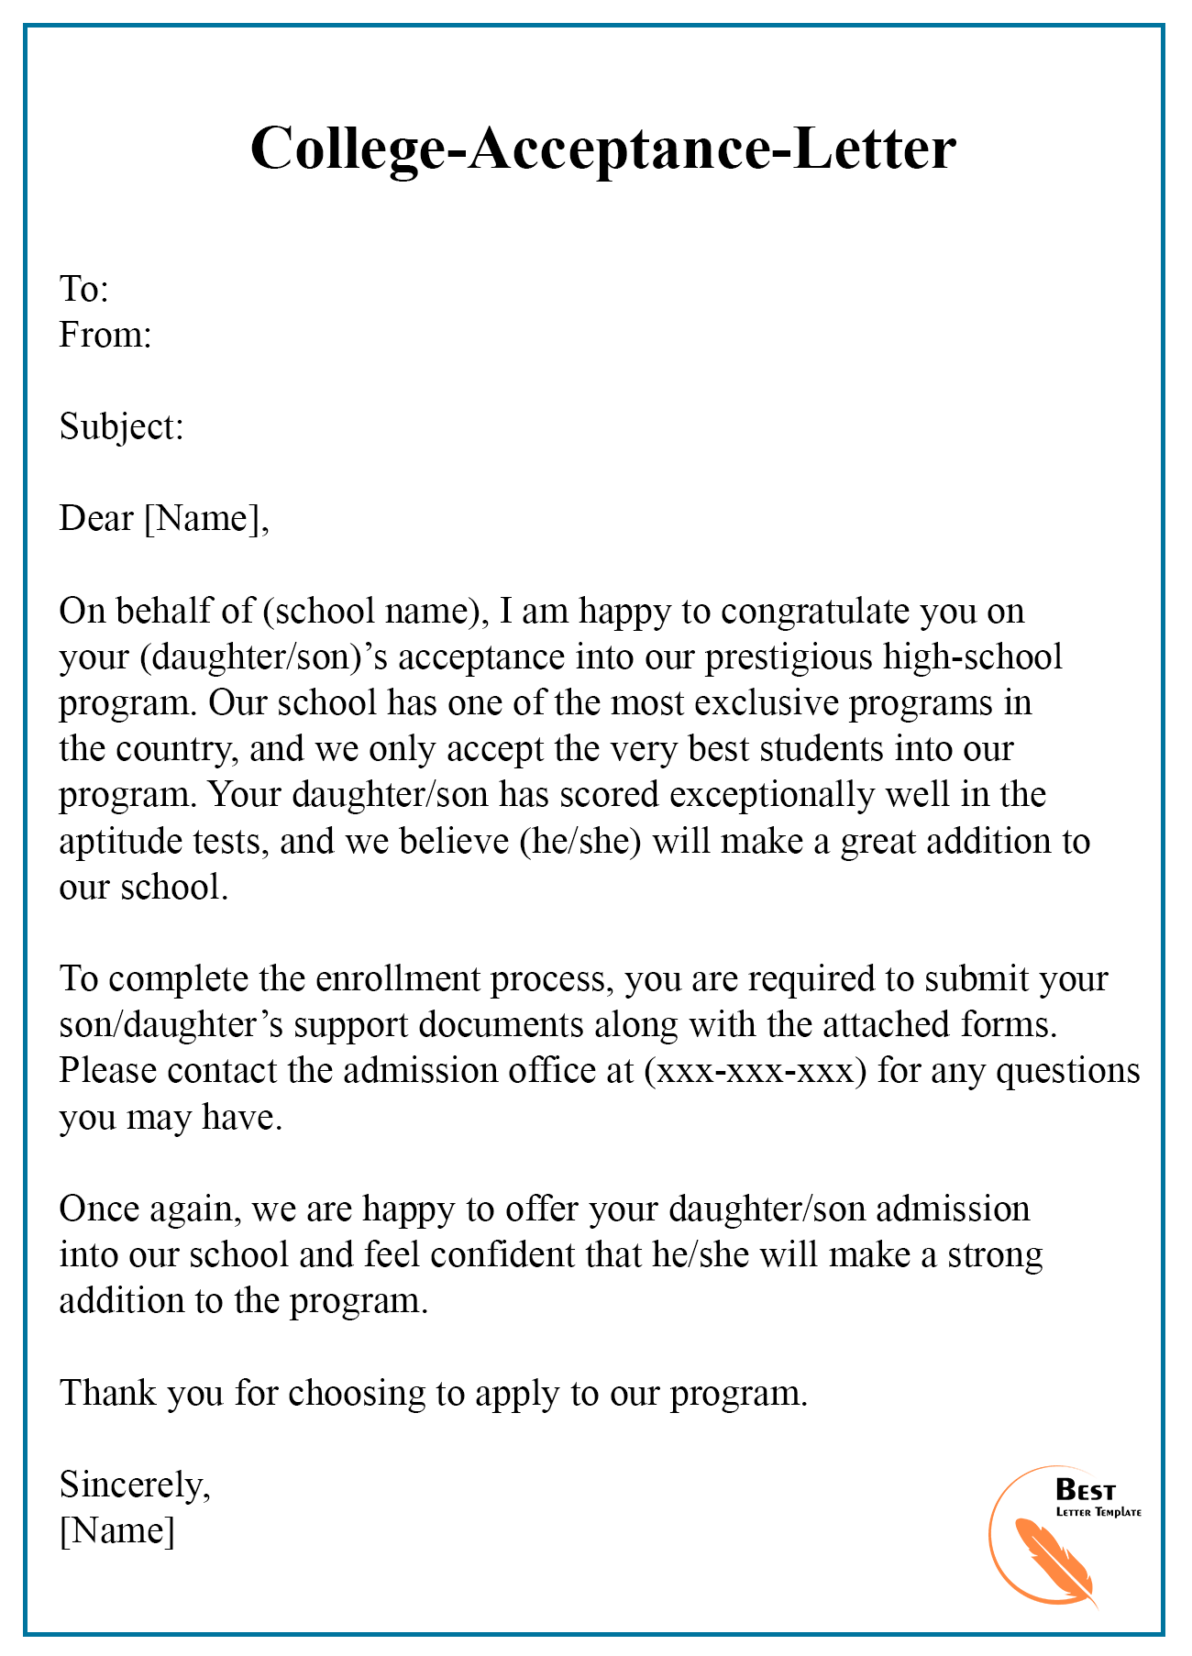
CASE FILE · 2017
Harvard pulled 10 offers — over a group chat.
At least 10 incoming freshmen had their admission offers revoked after sharing offensive memes in a private Facebook group chat for the admitted class.
"Private" didn't matter. "It was a joke" didn't matter. The offers were gone before a single class began.
[ PHOTO: campus gates / acceptance letter ]
Notes:
The most relevant case for this room. In 2017 Harvard rescinded admission offers to at least 10 incoming freshmen who shared offensive and violent memes in a private Facebook group chat for admitted students. Key point: it was 'private,' it was a joke to them, and it still ended their Harvard plans before classes began.

Slide 9
CASE FILE · WHEN THE PAST RESURFACES
Time doesn't protect you. Receipts do.
2019
2018
Stepped down from the Oscars
Fired over decade-old tweets
A comedian lost the biggest hosting job in entertainment after jokes from ~8–10 years earlier resurfaced. The tweets were old; the consequence was brand new.
A blockbuster director was dropped by a major studio when 10-year-old offensive posts were dug up and circulated. He was later rehired — but only after months of fallout.
Notes:
Two famous examples that show time is no shield. Kevin Hart stepped down from hosting the 2019 Oscars after old jokes from roughly 2009-2011 resurfaced. James Gunn was fired by Disney in 2018 over decade-old offensive tweets (later rehired). The pattern: you become notable, then people dig.

Slide 10
02
The Permanence of the Internet
Why "delete" is the most misleading button on your phone.
Notes:
Section divider. The core misconception students hold: that deleting something makes it gone. It doesn't.

Slide 11
SECTION 02 · PERMANENCE
"Delete" doesn't mean deleted
The second you post, copies exist that you no longer control. Here's where they live:
1
Screenshots
Saved to someone's camera roll in a single tap — before you ever reconsider.
2
Reposts & shares
Once it's shared, it lives on accounts you can't reach or delete.
3
Search caches
Search engines store snapshots that can outlive the original page.
4
Archive sites
Anyone can permanently save a public page in seconds, on purpose.
5
Company servers
Platforms keep backups long after your post disappears from your view.
Notes:
Explain the five ways content survives deletion. The mental model to give them: the moment you hit 'post,' you've made copies you no longer control. Deleting your copy doesn't recall theirs.

Slide 12
SECTION 02 · THE INTERNET KEEPS THE RECEIPTS
900B+
web pages archived by the Wayback Machine — and anyone can save yours in one click.
There is a free public tool whose entire purpose is to remember the internet forever. Deleting your copy does nothing to its copy.
Notes:
The Internet Archive's Wayback Machine has archived hundreds of billions of web pages and keeps growing. Point: a free, public tool exists whose entire job is to remember the internet forever. Saving a page takes one click.

Slide 13
SECTION 02 · PERMANENCE
How an old post comes back
STEP 1
STEP 2
STEP 3
STEP 4
You post
You forget
You're noticed
It resurfaces
A throwaway joke or hot take at 14. Nobody reacts.
Years pass. You'd never post it now — but it's still there.
You apply, get hired, win, or go viral. Now you're worth checking.
Someone digs, screenshots, and shares. The post didn't change — your audience did.
Notes:
The resurfacing pattern. Most posts are ignored at first. The danger arrives later — when you apply, get hired, run for something, or go viral. That's the trigger that makes people dig. The post didn't change; your visibility did.

Slide 14
03
Cleaning Up
How to tidy your trail — and the honest limits of what cleanup can do.
Notes:
Section divider. Now the hopeful part — what you can actually do. But be honest: cleanup has limits, which we'll cover next.

Slide 15
SECTION 03 · CLEANING UP
The clean-up playbook
01
Audit yourself
02
Lock it down
Google your name and every old username. See what a stranger sees.
Set accounts to private and review who can tag or message you.
03
Delete the obvious
04
Untag & ask
Remove posts you wouldn't want a coach, recruiter, or grandparent to read.
Remove tags and ask friends to take down posts you're in.
05
Set up alerts
06
Bury it with good
Create a name alert so you know when something new appears about you.
Publish real, positive content — projects, awards — so it ranks first.
Notes:
Practical, do-it-tonight steps. Number 6 is the pro move: you can't always delete the bad, but you can publish good, real content (projects, achievements) that ranks higher and tells your story first.

Slide 16
THE HONEST LIMIT
The 3-second test, before you post:
Cleanup can't reach what's already copied.
Would I be fine with my grandparent, my dream college, and my future boss seeing this — forever?
If it's been screenshotted, archived, or reshared , deleting your copy changes nothing. The only protection that always works happens before you post.
Notes:
The honest limit. Cleanup helps with what's still under your control. It does nothing for content that's already been screenshotted, archived, or reshared. So the only true protection is upstream: the pause before you post. Introduce the grandma/college/boss test.

Slide 17
★
CLASS ACTIVITY · 8–10 MIN
The Digital Time Capsule
Imagine opening your current feed in five years . Answer honestly — for your eyes only.
Q1
Q2
Q3
Which post would you delete first — and why does future-you cringe?
If a college or employer saw your last 10 posts, what story would they tell?
What's one post you're proud of — that actually represents you well?
Notes:
The activity. Give them 8-10 minutes. They imagine opening a time capsule of their current feed in 5 years. Have them privately journal answers, then discuss as a class what 'future-proof' posting looks like. No phones required, but they can scroll their own feed if comfortable.

Slide 18
◆
THE TAKEAWAY
Your personal brand protection plan
1
Pause before you post — assume it's permanent and public.
2
Run the grandparent / college / boss test, every time.
3
Audit your name and old handles once a term.
4
Keep DMs and private chats genuinely private — they screenshot.
5
Separate accounts you don't want linked — don't reuse handles.
6
Build a positive trail — post what you're proud of.
7
Own your mistakes early — context and growth beat a cover-up.
Pick TWO to start this week.
Notes:
The deliverable. Their Personal Brand Protection Plan — seven habits. Frame it as protecting an asset they're building, not just avoiding trouble. Have them pick the two they'll start this week.

Slide 19
WEEK 7 · WRAP-UP
The internet has no undo button. You have a pause button.
Your reputation isn't something you fix later — it's something you're building right now, one post at a time. Protect it.
Notes:
Land the plane. The internet has no undo button, but you have a pause button. Their reputation is something they're building right now, one post at a time. End by asking which two habits they chose.

